Slide 1
IDEAS FOR PROBLEM STATEMENT

Slide 2
Infant Cry Language Analysis and Recognition:
Determine the reason for cry of the infants may be hunger,sleepy,pain
Dataset: https://www.kaggle.com/pengliu1997/infantcrying?
http://www.ieee-jas.org/fileZDHXBEN/journal/article/zdhxbywb/2019/3/PDF/jas-6-3-778.pdf
Madhurika Ganiger

Slide 3
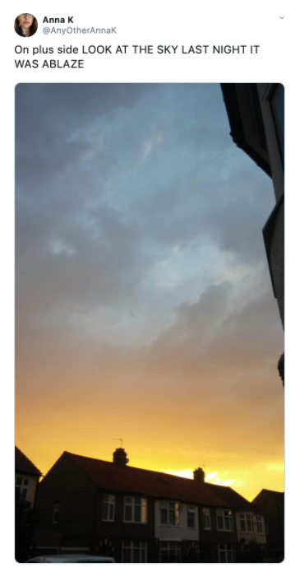
Real or Not? NLP with Disaster Tweets
Twitter has become an important communication channel in times of emergency.
The ubiquitousness of smartphones enables people to announce an emergency they’re observing in real-time.
Because of this, more agencies are interested in programatically monitoring Twitter (i.e. disaster relief organizations and news agencies).
https://www.kaggle.com/c/nlp-getting-started
Varun Bohara

Slide 4
Combating On​line Ho​st​ile Posts in ​Regional L​anguages dur​ing Emerge​ncy Si​tuation
This subtask focuses on a variety of hostile posts in Hindi Devanagari script collected from Twitter and Facebook.
The set of valid categories are fake news, hate speech, offensive, defamation, and non-hostile posts.
It is a multi-label multi-class classification problem where each post can belong to one or more of these hostile classes. However, the non-hostile posts cannot be grouped with any other class.
https://competitions.codalab.org/competitions/26654#learn_the_details-overview
Varun Bohara

Slide 5
Quick Draw
These doodles are a unique data set that can:
Help developers train new neural networks,
Help researchers see patterns in how people around the world draw,
And help artists create things we haven’t begun to think of.
https://quickdraw.withgoogle.com/data
The Neural Integration Of Speaker and Message.
https://academic.oup.com/cercor/article/17/10/2322/311033
On line Integration of Semantic Information from Speech and Gesture:
Insights from Event -related Brain Potential
https://www.mitpressjournals.org/doi/abs/10.1162/jocn.2007.19.4.605
When Language Meets Action :
The Neural Integration of Gesture and Speech
https://academic.oup.com/cercor/article/17/10/2322/311033
Sakshi T

Slide 6
1. The thermodynamic stability of perovskite oxides:
Aim : Determining the thermodynamic stability of perovskite(Crystal structure).
Links :
Data Article 1
Data Article 2
GitHub
Abhishek Rao

